Slide 1

WTM Berlin
6th of September

Slide 2




2nd and 4th Wednesday of the month
@soundcloud
1st and 3rd Tuesday of the month
@immobilienscout24

Slide 3
WTM Berlin
Backend go-bridge

Slide 4

Calendar backend go-bridge
Sessions:
2016-09-14
2016-09-28
2016-10-12
2016-10-26
2016-11-09
2016-11-23
2nd and 4th Wednesday of the month @soundcloud
More details at the fb group, fb page and meetup

Slide 5

WTM Berlin
Android Study Jam
6th of September

Slide 6

WIFI
SSID: WTM
PW: WTM_2016
please don’t share outside of meetup
tweet pics and ideas:
#WTMberlin

Slide 7

Agenda
Intro (~15 min.)
Workshop (~1 hour)
Android for Beginners: Lesson 1 Quiz-Game
Introduction to Object Oriented Java
Q&A, self-learning and networking (aka don’t be shy)

Slide 8
Calendar android study jam
Sessions:
2016-09-20
2016-10-04 - Beginners Lesson 2
2016-10-18
2016-11-01 - Beginners Lesson 3
2016-11-22 (because DevFest)
2016-12-06
Beginners Graduation and project presentation
1st and 3rd Tuesday of the month @immobilienscout24 More details at the fb group, fb page and meetup

Slide 9
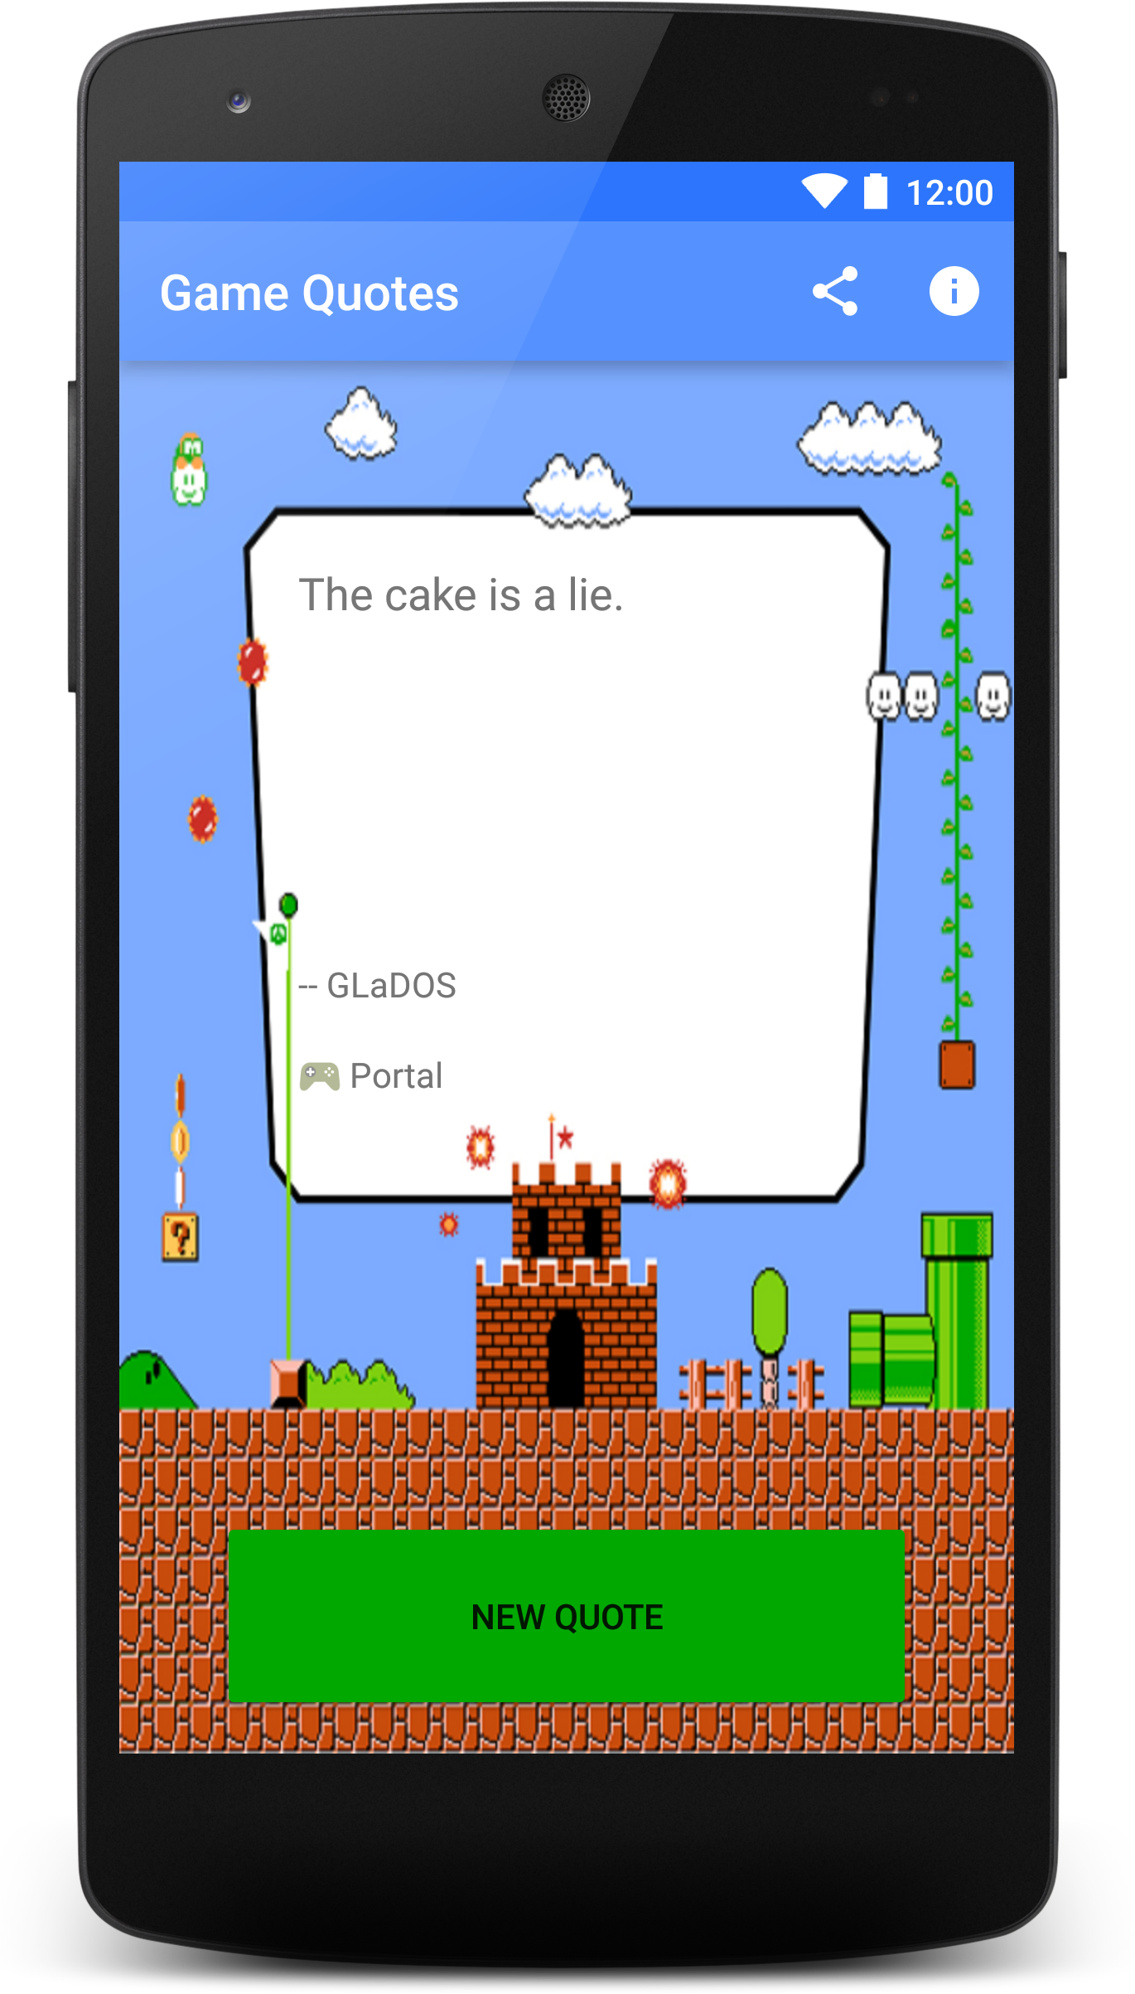
Beginners Projects
Single Screen App.
With things you learned at the course:
Layouts, ImageView, TextView, Buttons…
Open a browser, a location in Google Maps, a share intent...
Out Of Scope:
No storing things in phone
No network usage
Need ideas? Here’s some!
List of cool places to visit.
Quiz game.
Teach things to the user.
… or ask us!
Presentation: 2016-12-06

Slide 10
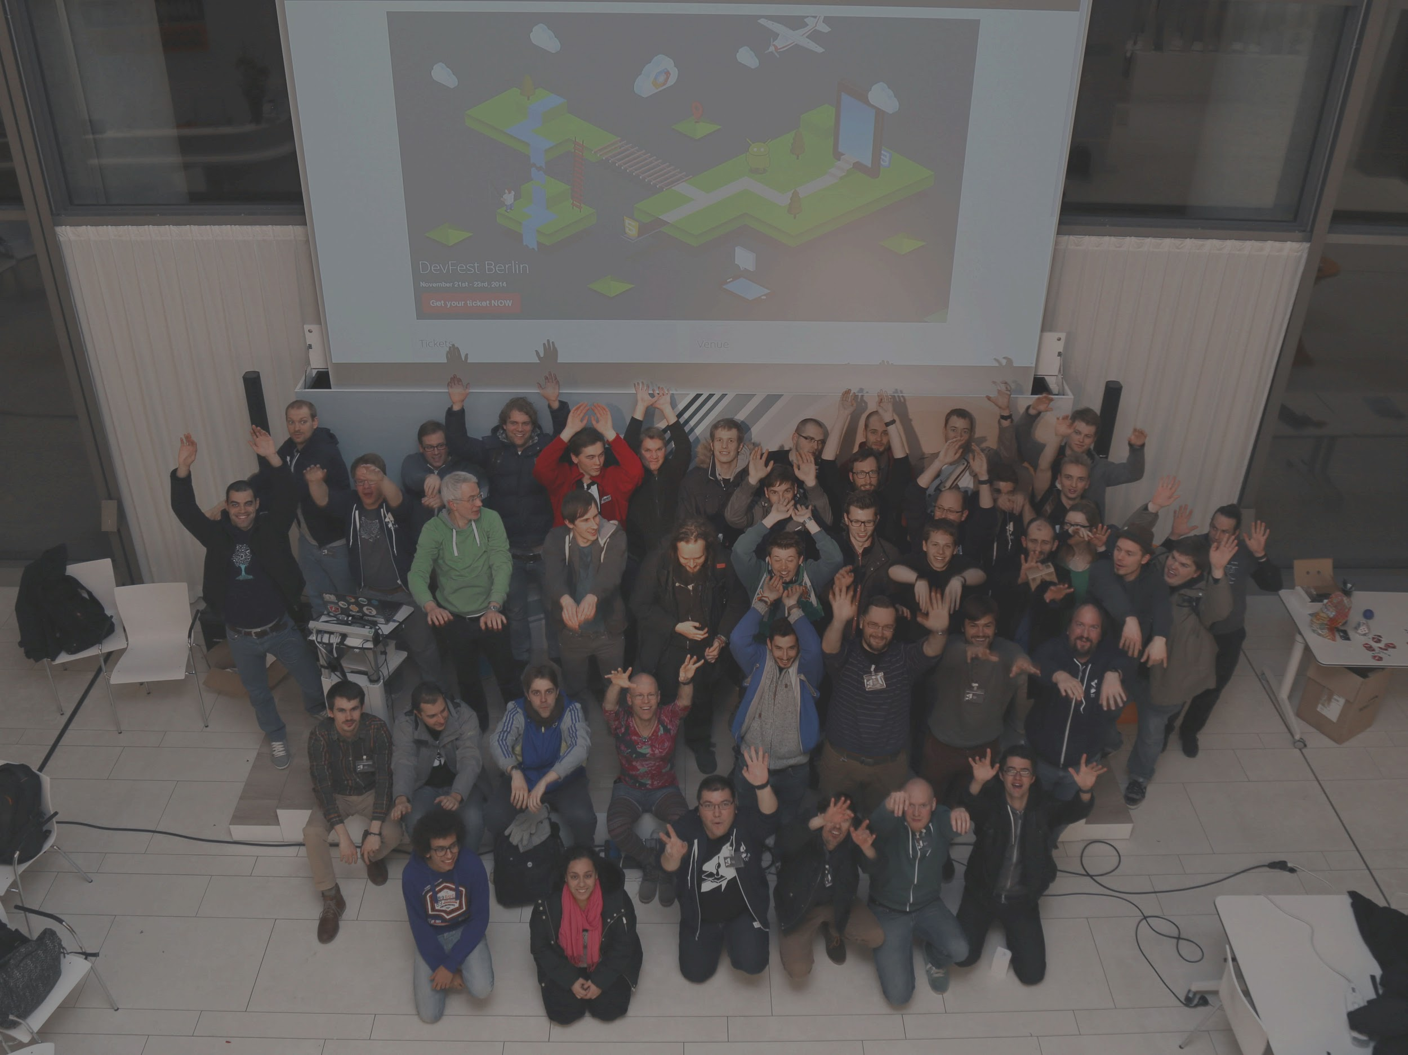

DevFest Berlin 2016 is coming!
November 11-12 @ ImmobilienScout24
Call For Papers till 27th September!
https://www.papercall.io/devfest-berlin-2016
Call For Volunteers!
http://bit.ly/devfest-berlin-volunteers

Slide 11

Getting on Slack
http://adg-berlin.herokuapp.com/
Join channel #wtm-study-jam
You are very welcome to join other channels as well!
Anyone needs help getting on Slack?

